Slide 1

Preventive and prescriptive skin cancer solution
Submission: https://bit.ly/2HZWALj
GitHub Upload:
ISIC Challenge: Skin Lesion Analysis Towards Melanoma Detection
Anuj Vasa
Aureo Zanon Jr.
Aureo Zanon Neto
Martina Beverly
Mohit Jha

Slide 2
Prepared for judges
Clare A. Wefelmeyer
Dadong Wan
Davide Olivieri
Matt David
Monika Sawyer
Sumeet B. Mahajan
Judging Criteria and scoring. Final score is the total awarded in each of the categories
Criteria Possible | Points
Innovation | 1-10
Technical Achievement | 1-10
Application | 1-10
Total Possible | 30

Slide 3

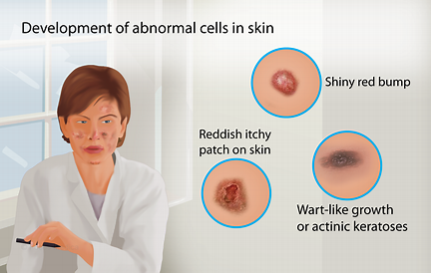
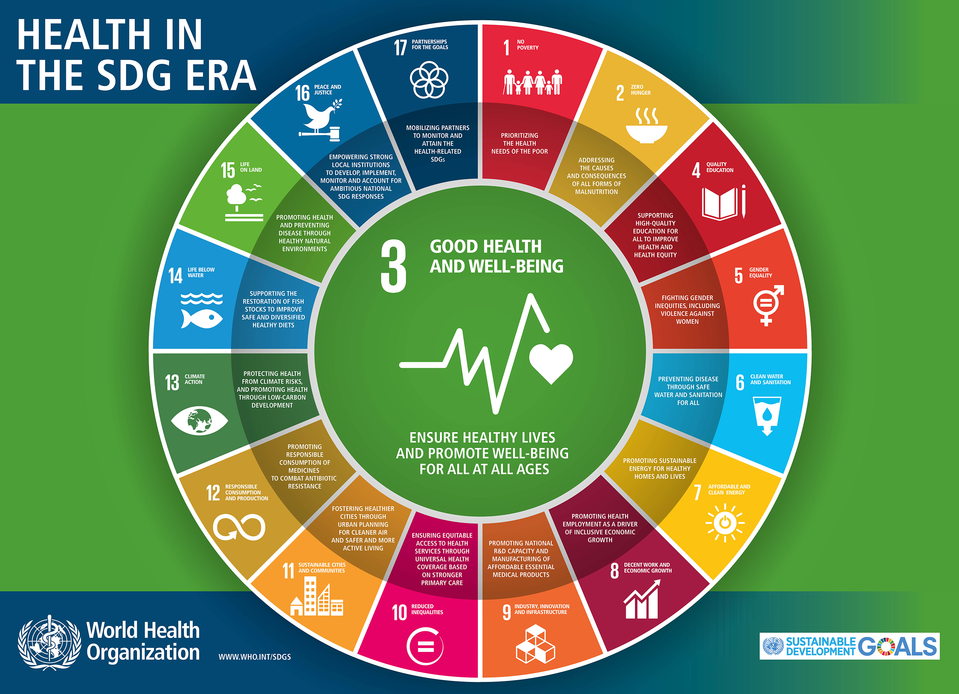
Case
Data set: 23,000 JPEGs (23 GB)
Metadata:
Unstructured
Date of JPEG
Localization of body part
Lesion Diagnosis: Benign or Malignant
Bias: pics show color codes that skew our app’s results; required identifying neutral
UN SDG #3 Health

Slide 4
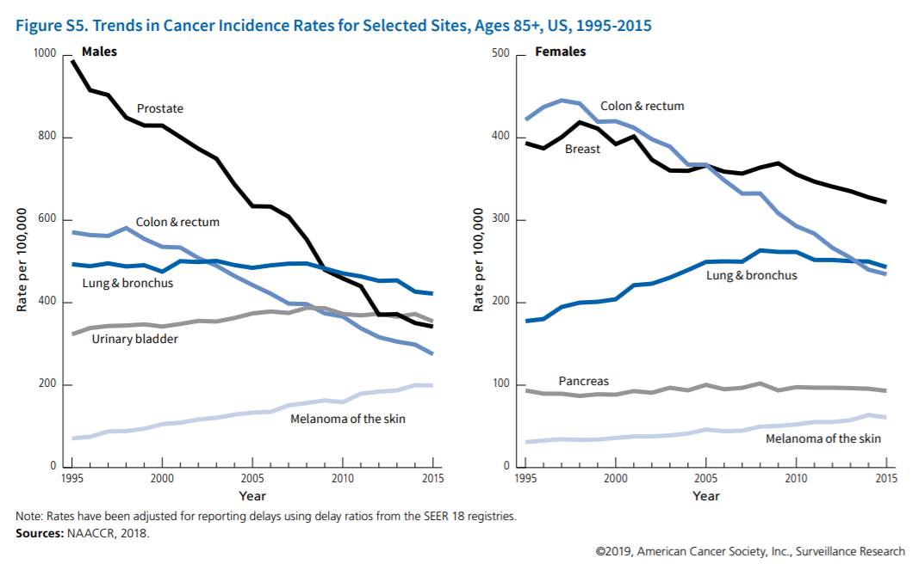
skin cancer Facts & Statistics
One in five Americans will develop skin cancer by the age of 701
Melanoma is predicted to become the second most commonly diagnosed cancer among men 85 and older by 2030
UN WHO - Annually:
2-3 million non-melanoma skin cancers
132,000 melanoma skin cancers
10% decrease in ozone levels: additional ~300,000 non-melanoma, ~4,500 melanoma skin cancer cases

Slide 5
skin cancer Facts & Statistics Contd..
U.S. more skin cancer diagnoses than all other cancers combined (e.g., basel cell carcinoma (BCC), squamous cell carcinoma (SCC))
Annual cost of treatment:
~$8.1 B (~$.48 B non-melanoma, ~$3.3 B melanoma)
~$343.1 M attributed to indoor tanning
Organ transplant patients 100x more likely SCC
Ozone level related (non-melanoma): ~90%
5+ sunburns doubles melanoma risk

Slide 6
skin cancer Facts & Statistics ConTD..
Melanoma estimates for 2019
~7.7% increase in case diagnoses
~22% increase in melanoma related deaths
~7,230 deaths expected (4,740 men, 2,490 women)
Invasive melanoma case diagnoses (2008-2019)
~54% increase/annually
Treatment of stage I melanoma
<30 days of biopsy
30-59 days of biopsy: 5% higher risk of death
>199 days of biopsy: 41% higher risk of death
Survival rate
92% avg. 5-year survival rate
98% avg. 5-year survival rate for early detection
64% when lymph nodes are reached
23% disease metastasizes to distant organs

Slide 7
Existing alternatives in the market & Unmet Needs
Apps – e.g., VisualDX, SkinVision
Not designed for continuous monitoring
Some are “Awareness raising” apps
Even where the technology is efficient, if it has not been combined with specialist input from a dermatologist, it may not pick up on all red-flag symptoms – missing the learning loop.
Doctors –
Limited practice in treating skin cancer patients
Human error (false +ve/-ve)

Slide 8
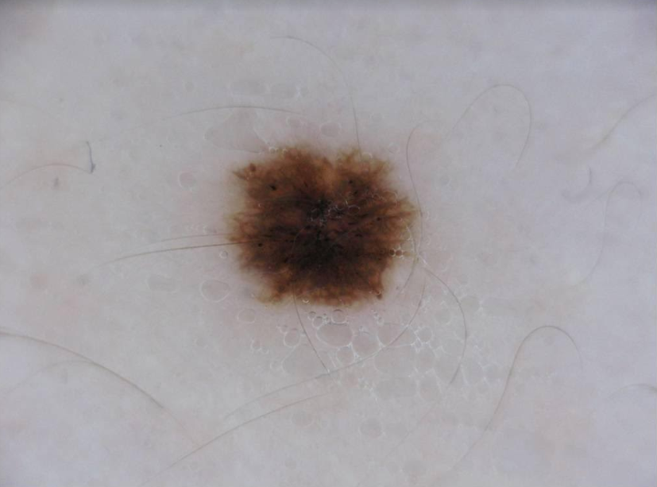
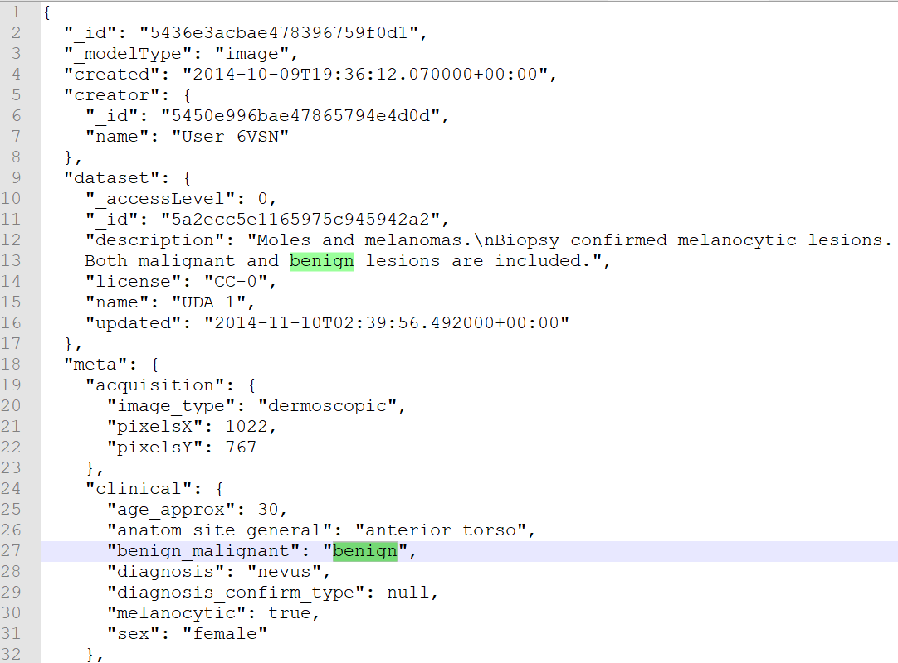
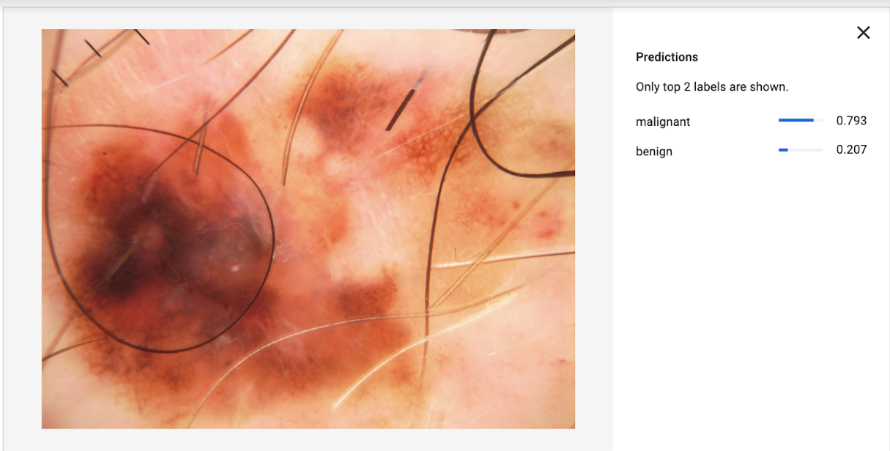
Our solution
Tools used - Google Cloud Platform – AutoML, Vision API, Cloud Storage
Training -
We performed preliminary Training with 200 images
Additional training time required to train with the entire data set
Image fed to our model
Metadata of the image
Process –
We uploaded a new image not seen by AutoML during training.
Evaluation –
The image shows the probability of malignancy as seen.
Output of our Solution

Slide 9
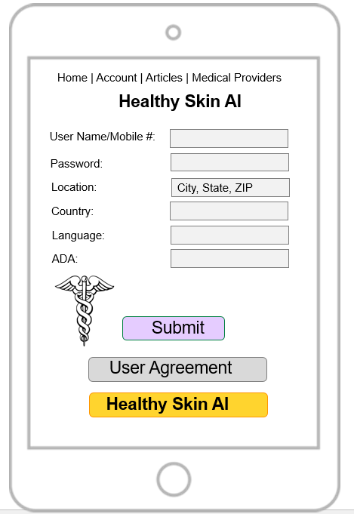
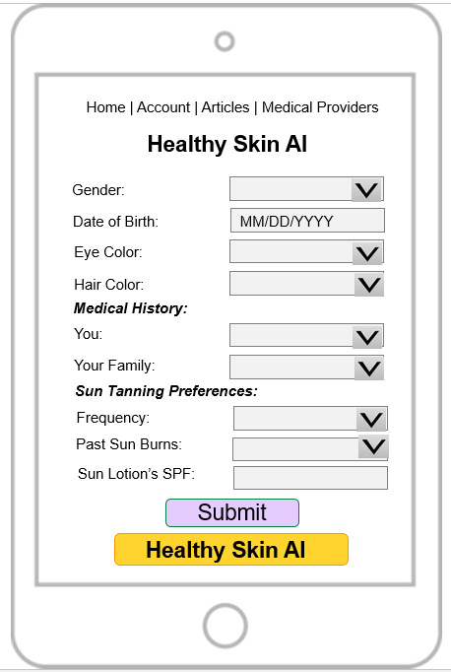
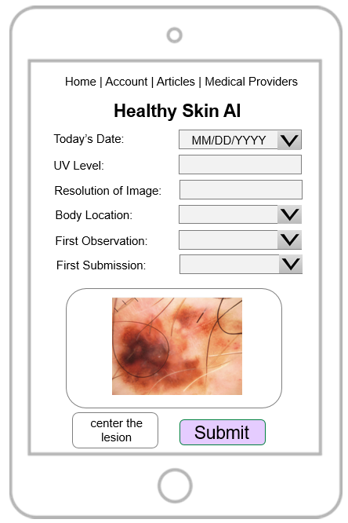
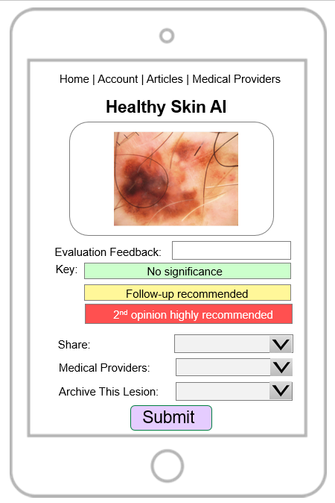
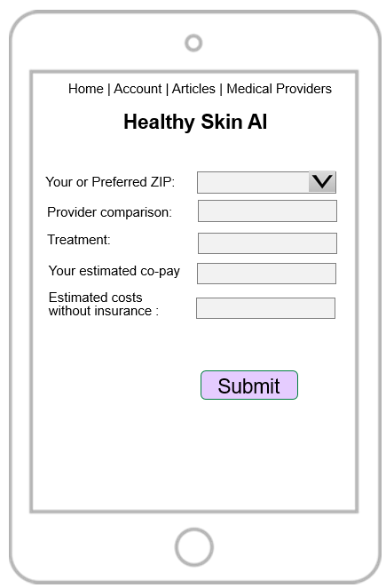
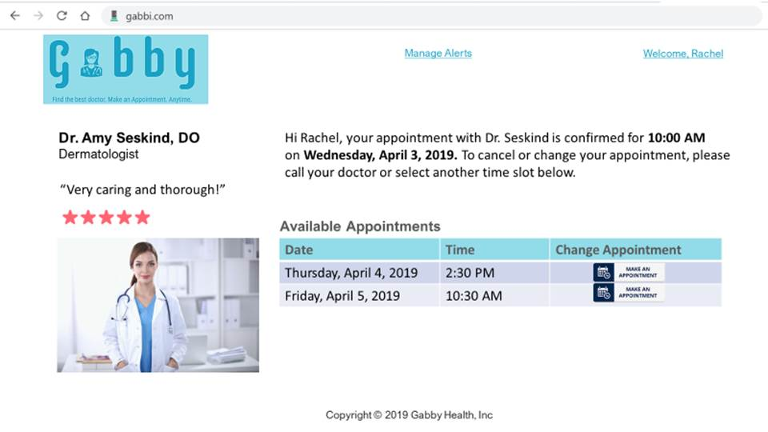
App – Healthy skin AI
Page 1 - UserInfo
Page 2 – Medical History
Page 3 – Skin Image
Page 4 – App results
Page 5 – Provider info

Slide 10
Unique value proposition
User
Registration with user’s mobile #
User account allows updating profile
Allows frequent monitoring & comparison of individual moles
Privacy (e.g, PII, GDPR)
App
Trained with 23K images + continuous learning
Improves intelligence due to Network effect
Combines cutting edge Google AutoML with latest data to accurately predict skin cancer

Slide 11
references
Darknet https://pjreddie.com/darknet/
International Skin Imaging Collaboration
https://www.isic-archive.com/#!/topWithHeader/onlyHeaderTop/gallery
Lean Canvas https://leanstack.com/leancanvas
The School of AI https://www.theschool.ai/
Skin Cancer Foundation https://www.skincancer.org/
UN Sustainability Developmental Goals 2030 https://www.un.org/sustainabledevelopment
https://cloud.google.com/vision/automl/docs/beginners-guide
https://medium.com/@dstepp2/using-gcp-automl-vision-to-predict-firearm-make-model-from-ballistic-images-55a7ca6086db
https://cloud.google.com/vision/automl/docs/tutorial
https://www.sciencedaily.com/releases/2018/07/180705113940.htm

